Slide 1


HEP NTUA Weekly Report 1/6/2022
George Bakas

Slide 2
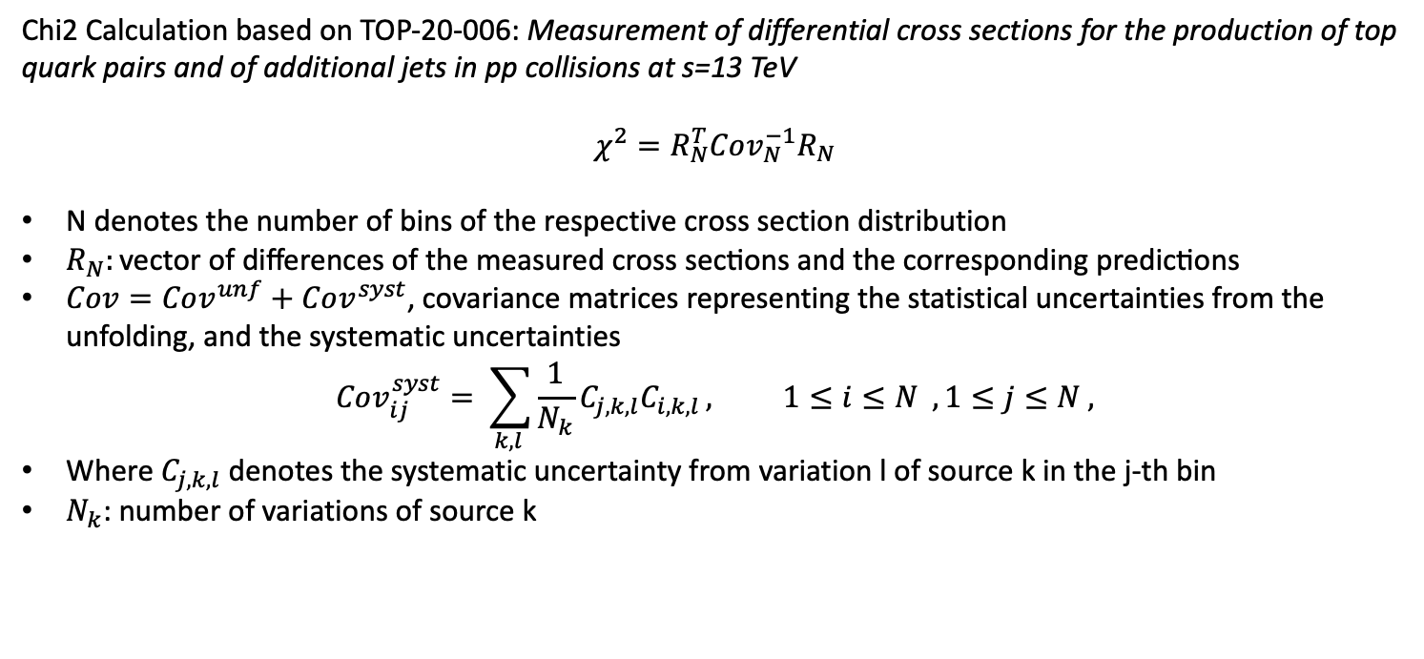
Summary
ttX analysis:
Integrate chi2 results in our final results
Send an email to set up pre-approval
AN 1st draft is almost ready
Begin to write paper
Chi2 Calculation based on TOP-20-006: Measurement of differential cross sections for the production of top quark pairs and of additional jets in pp collisions at s=13 TeV
$$χ^{2}=R_{N}^{T}Cov_{N}^{−1}R_{N}$$
N denotes the number of bins of the respective cross section distribution
$R_{N}:\text{vector} \text{of} \text{differences} \text{of} \text{the} \text{measured} \text{cross} \text{sections} \text{and} \text{the} \text{corresponding} \text{predictions}$
$Cov=Cov^{unf}+Cov^{syst}$, covariance matrices representing the statistical uncertainties from the unfolding, and the systematic uncertainties
$$Cov_{ij}^{syst}= \sum_{k, l }{\frac{1}{N_{k}}C_{j,k,l}C_{i,k,l}}, 1≤i≤N , 1≤j≤N ,$$
Where $C_{j,k,l}$ denotes the systematic uncertainty from variation l of source k in the j-th bin
$N_{k}$: number of variations of source k

Slide 3
Final Results Parton

Slide 4
Final Results Particle

Slide 5
Final Results Parton

Slide 6
Final Results Particle

Slide 7
BACKUP

Slide 8
Summary
ttX analysis Pipeline Creation
We want to be able to handle all Nominal files and their variations in an automated way
This requires deciding consistent naming conventions and a efficient planning
Handling of:
Nominal
Parton Shower Weights
PDF Variations
JES
Scale Variations
bTagVariations
Top quark mass variations
Per year For all these we need to
Create template files that have 2btag and 0btag in Extended and Reduced jetMassSoftDrop phase space
9 variables (mJJ, pTJJ, yJJ, jetPt[0,1], jetY[0,1], chi, |cosTheta*|[0,1]
Template fit files (bkg qcd, bkg subdominant) and signal templates for all variations
Fit on extended signal region for all variations
Response matrices, Acceptance, Efficiency
Signal Extraction
Combine all Fiducial Level results (4 years) into 1 Extracted Signal for all variations
Unfold the combined result into Parton & Particle levels
Show systematic variations compared to the Nominal file
The same procedure must be done using different nominal files
Fill in 2btag histograms in our signal region in the parton
For each variation and each year
Combine all years together
Calculate systematics for samples other than the nominal

Slide 9
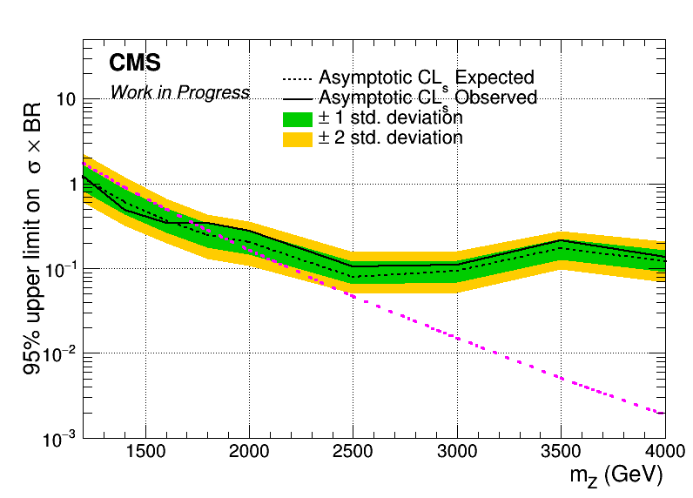
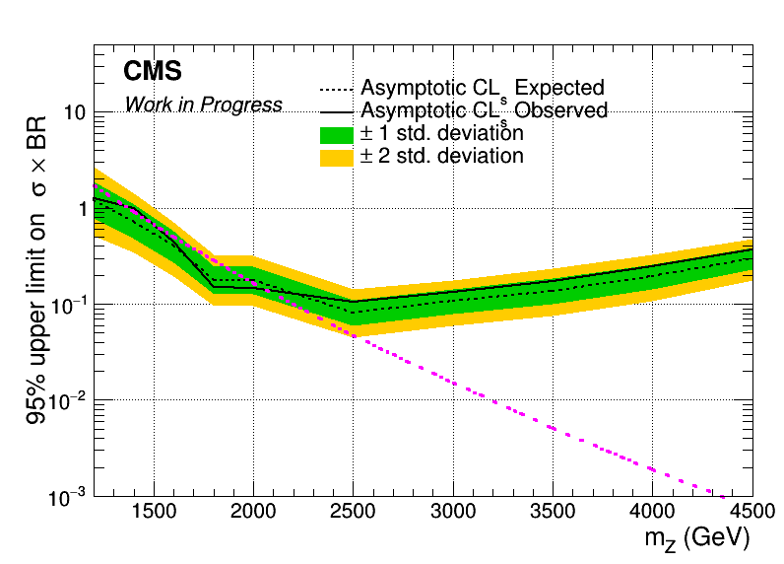
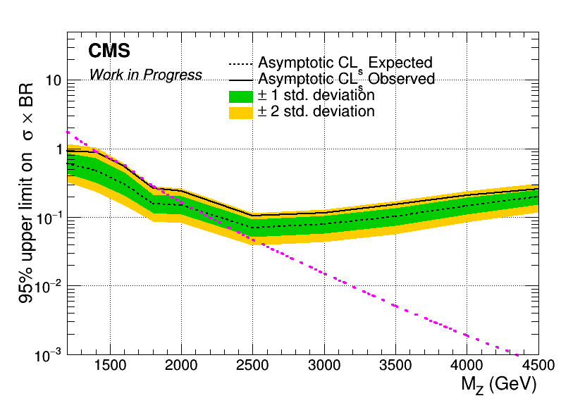
Brazilian Plots (2016_preVFP, 2017 and 2018) with sliding mJJ Cut
2016_preVFP
2017
2018

Slide 10
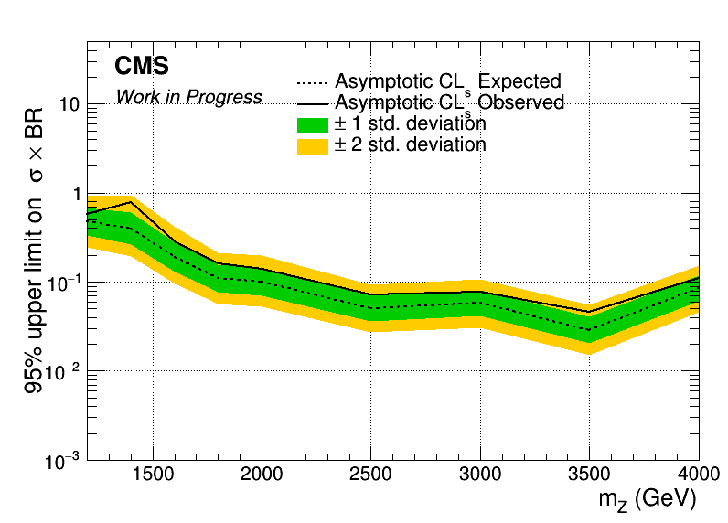
Combined Datacard for 2016_preVFP, 2017 and 2018
Mass Cut Mapping
{"mZ_1200_12":1000, "mZ_1400_14":1200, "mZ_1600_16":1400, "mZ_1800_18":1600, "mZ_2000_20":1600,
"mZ_2500_25":2000, "mZ_3000_30":2000, "mZ_3500_35":2000, "mZ_4000_40":2000, "mZ_4500_45":2000}

Slide 11
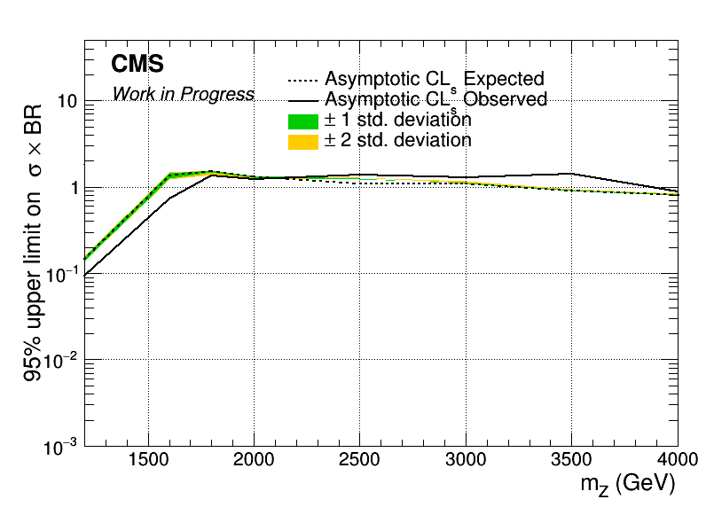
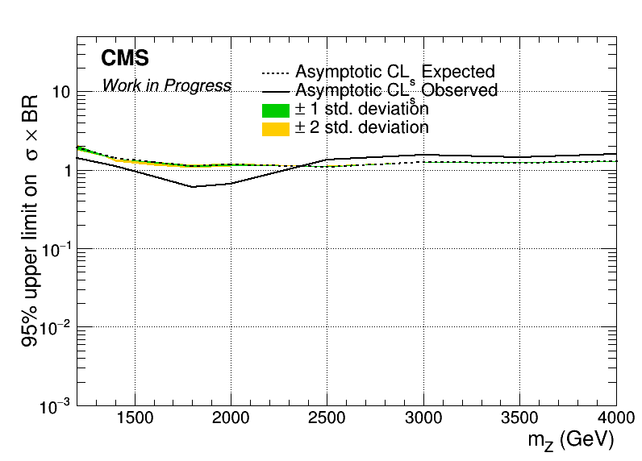

Brazilian Plots (2016_preVFP, 2017 and 2018) with sliding mJJ Cut wrt 2018
2016_preVFP
2017
2018

Slide 12
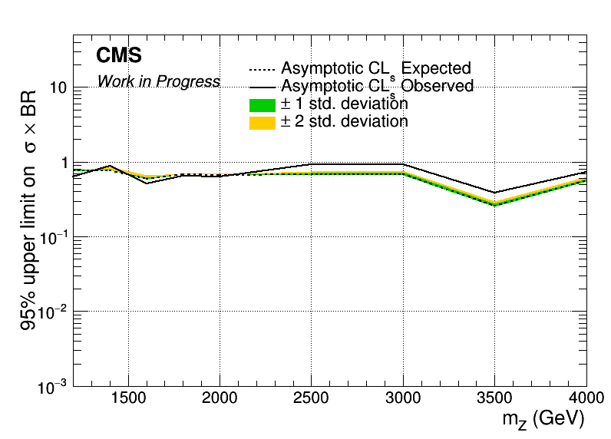
Combined Datacard for 2016_preVFP, 2017 and 2018 wrt 2018
Mass Cut Mapping
{"mZ_1200_12":1000, "mZ_1400_14":1200, "mZ_1600_16":1400, "mZ_1800_18":1600, "mZ_2000_20":1600,
"mZ_2500_25":2000, "mZ_3000_30":2000, "mZ_3500_35":2000, "mZ_4000_40":2000, "mZ_4500_45":2000}

